Slide 1
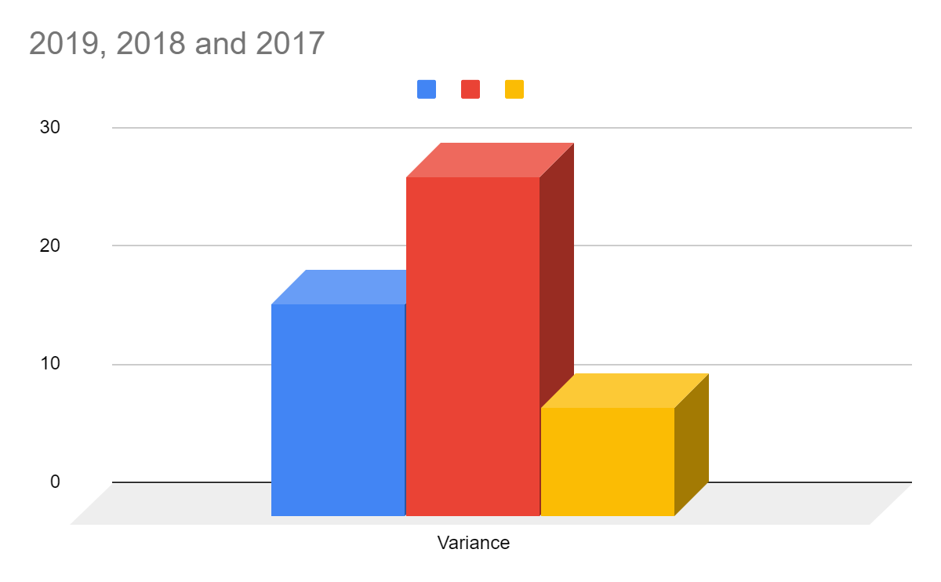
Variance inspects the volatility factor of a stock and measures the deviation of the stock from its mean. For Dunkin over the years the deviation seems to be a of a wide array as presented in the graph which means that there is high level of fluctuations in the prices of Dunkin brands stock over the years
Years | 2019 | 2018 | 2017
Variance | 17.9183 | 28.65155 | 9.209199

Slide 2
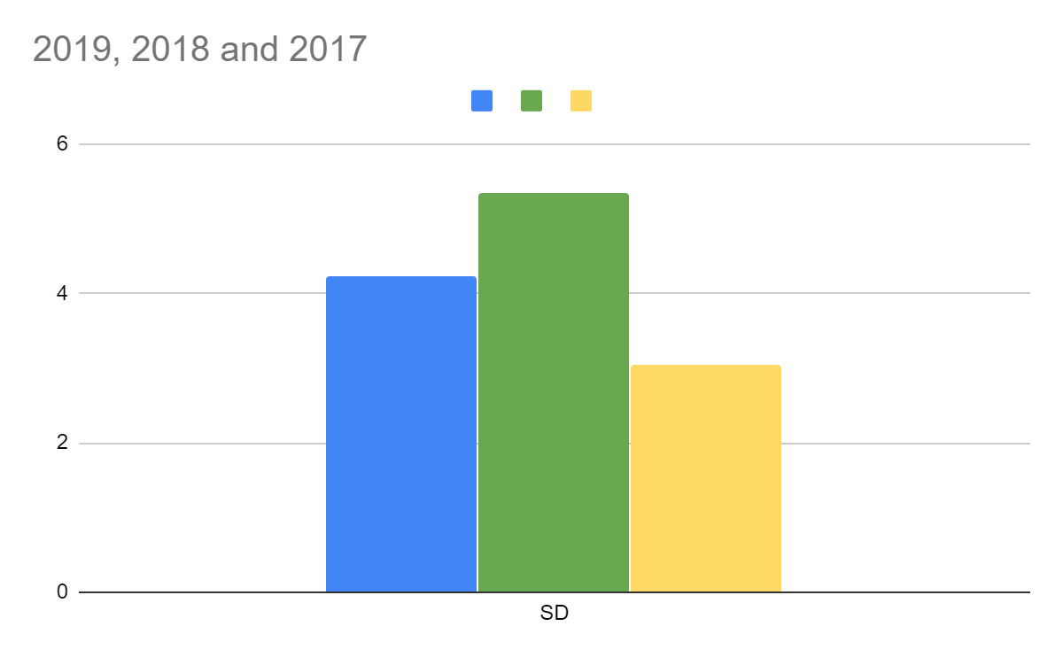
Standard Deviation
Years | 2019 | 2018 | 2017
SD | 4.233 | 5.3527 | 3.03466
As the name suggest Standard deviation based on the deviation of a stock measured through proposes the risk factor involved in the stocks portfolio. Based on the graph the risk involved over the last 3 years tend to remain in the range of 3-5% which suggests it percentage deviation from its mean.

Slide 3
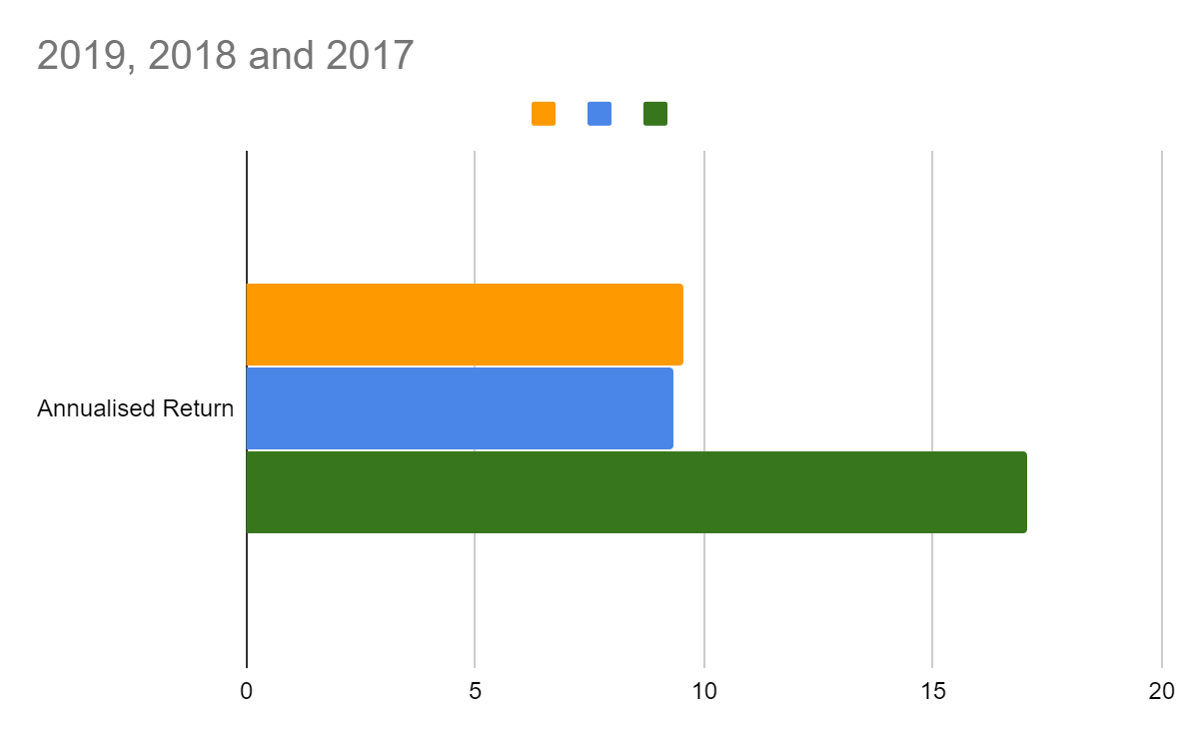
Years | 2019 | 2018 | 2017
Annualized Return | 9.553% | 9.314% | 17.0367%
Annualized returns have reduced since 2017 by approximately 8% over the years the reason could be the selling of owned franchise restaurants and buy back carried out in the year 2018. Company seems to grow over the years from the trading prospective. But considering the current scenario of covid – 19, returns are expected to plunge sharply

